Slide 1


Slide 2
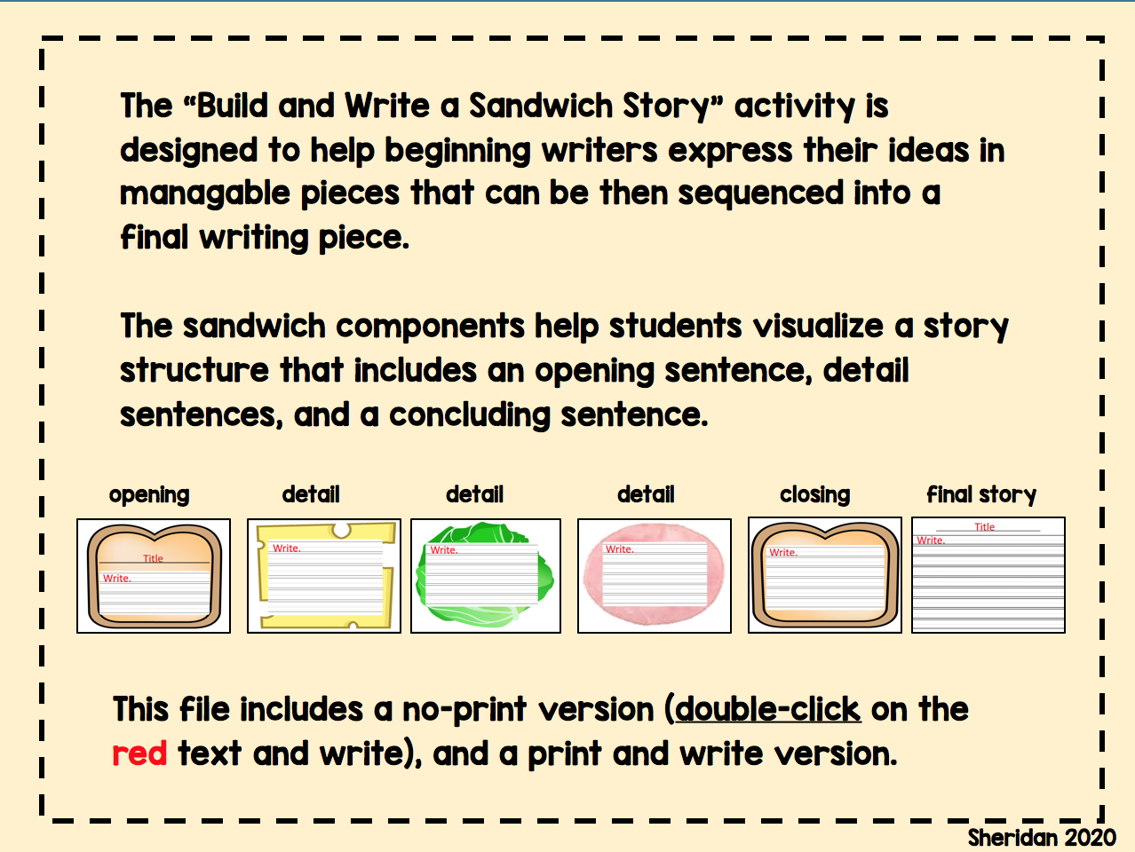

Slide 3

Title
Write.

Slide 4

Write.

Slide 5

Write.

Slide 6
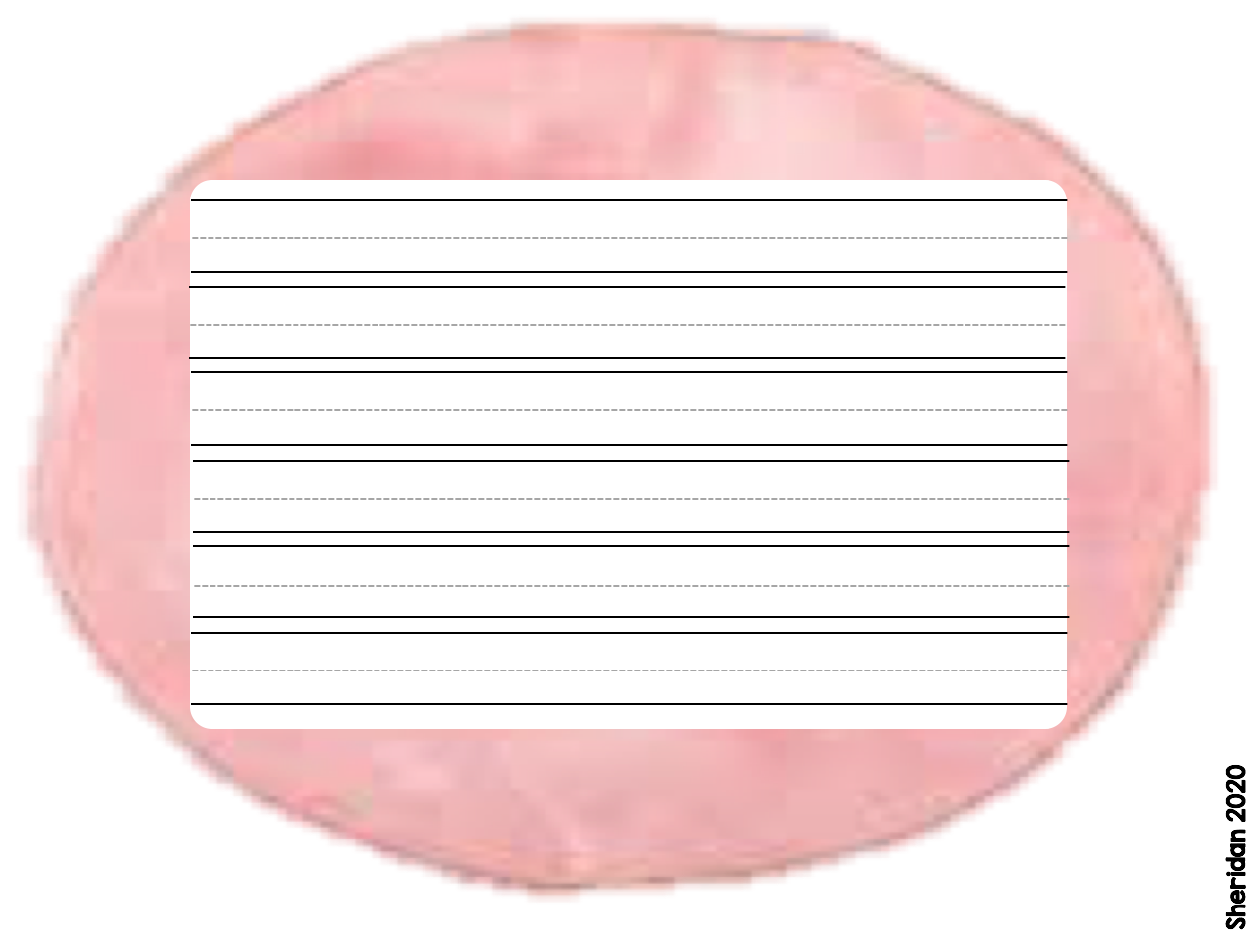
Write.

Slide 7

Write.

Slide 8
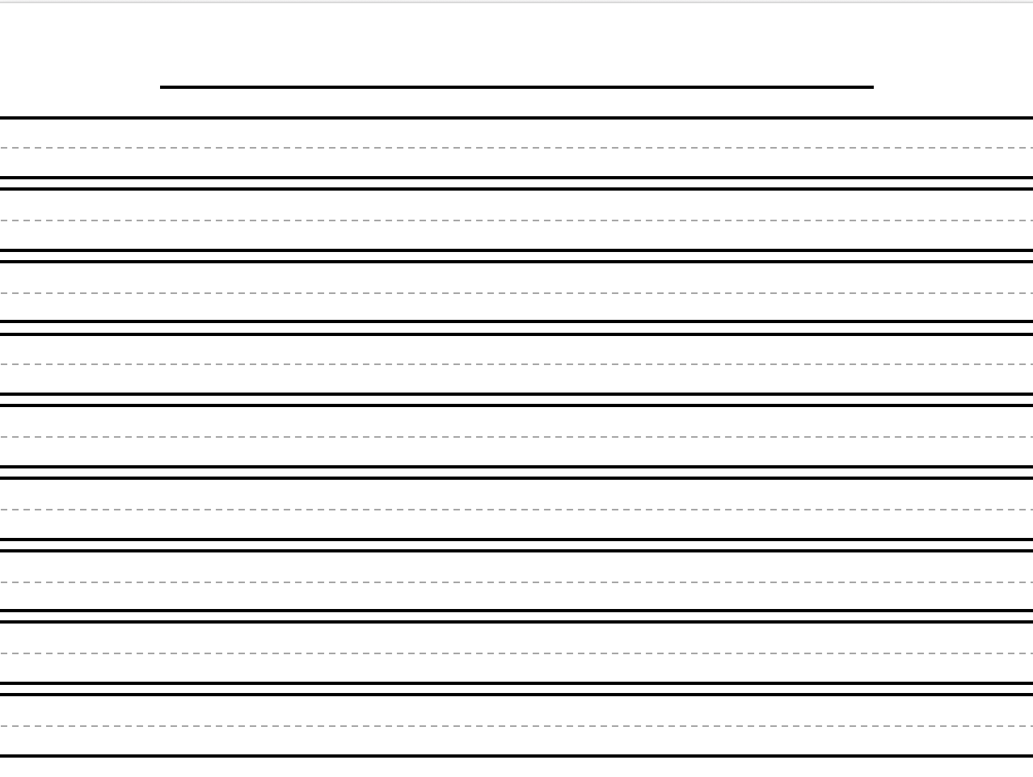
Title
Write.

