Slide 2
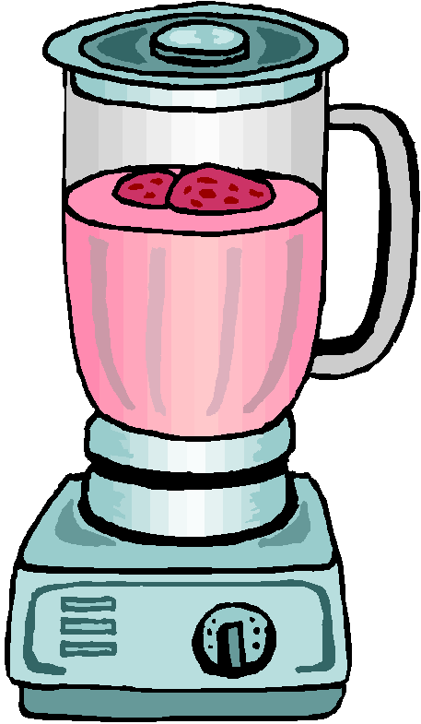
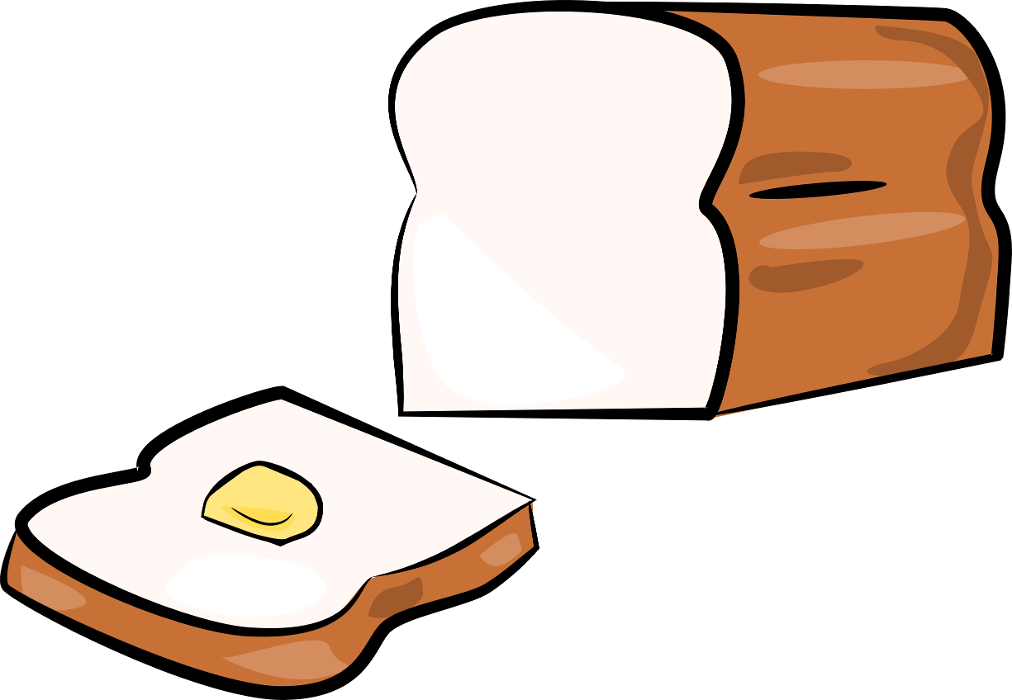
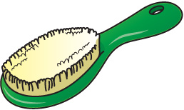
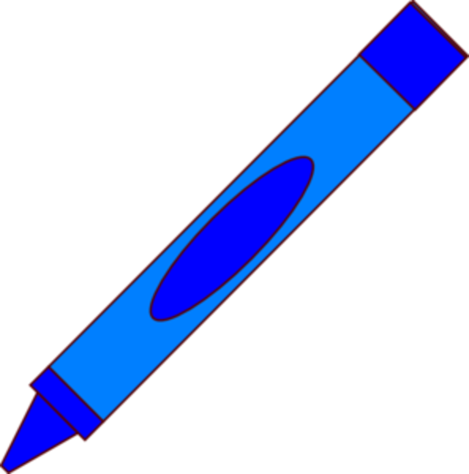
Name

Slide 3
Name
Double-click-to-type-here.
Double-click-to-type-here.
Double-click-to-type-here.
blocks
broom
brush
blue
bread
blender

Slide 4
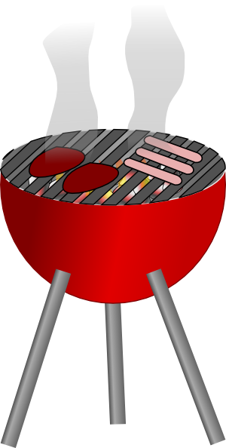
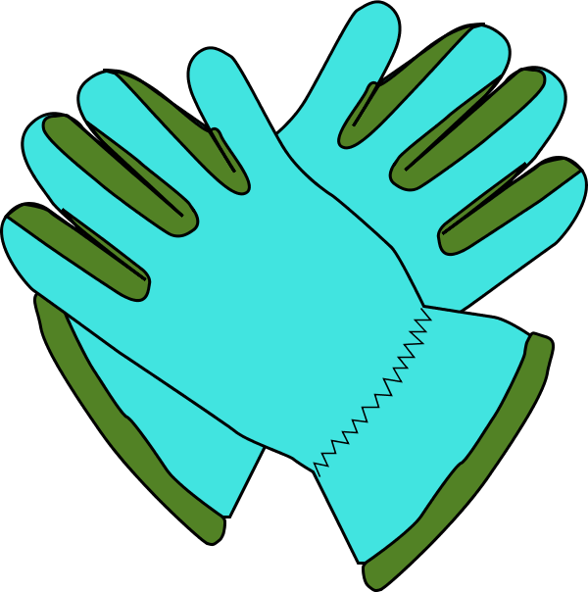
Name

Slide 5
Name
Double-click-to-type-here.
Double-click-to-type-here.
Double-click-to-type-here.
grass
glue
gloves
grapes
glasses
grill

Slide 6
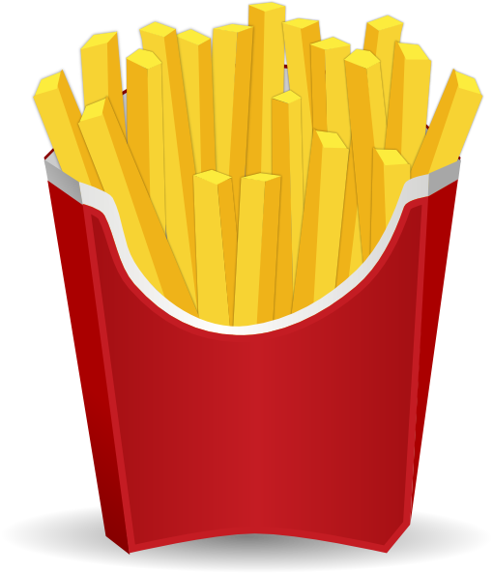
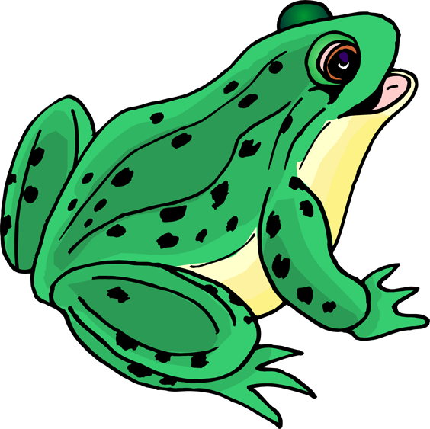
Name

Slide 7
Name
Double-click-to-type-here.
Double-click-to-type-here.
Double-click-to-type-here.
flower
frog
fries
fly
frame
flag

Slide 8
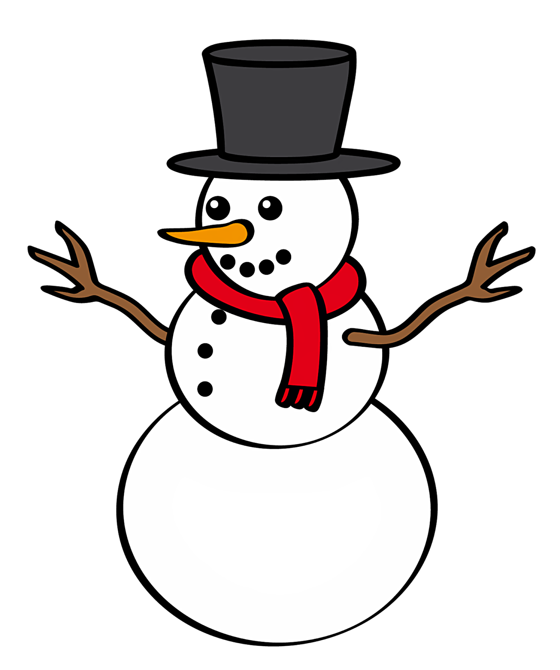
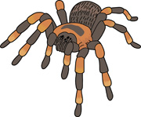
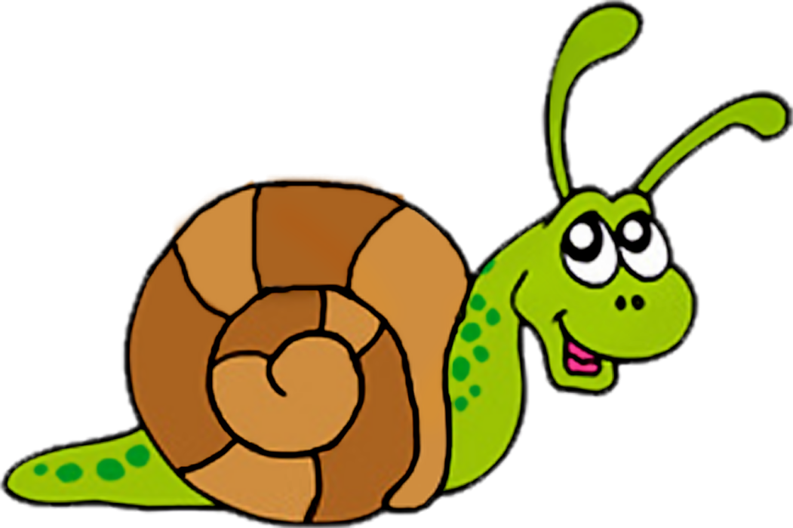
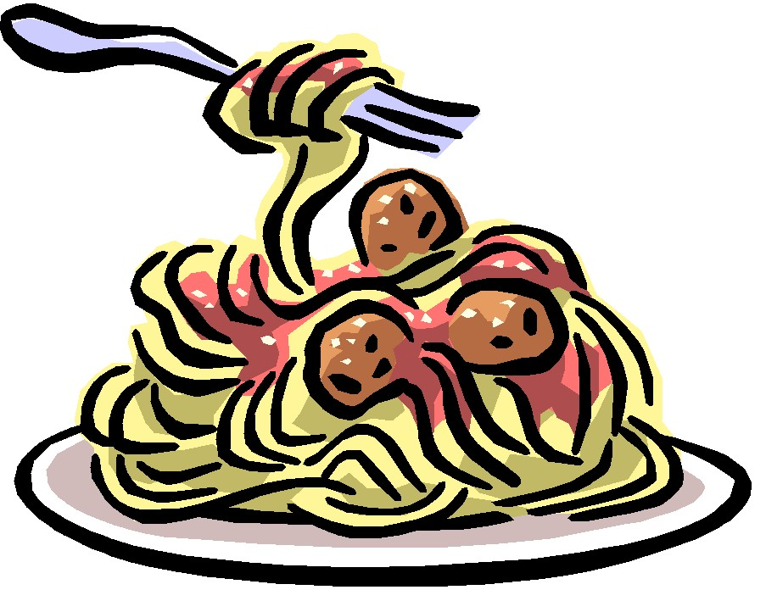
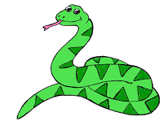
Name

Slide 9
Name
Double-click-to-type-here.
Double-click-to-type-here.
Double-click-to-type-here.
spider
spoon
snail
spaghetti
snowman
snake

Slide 10
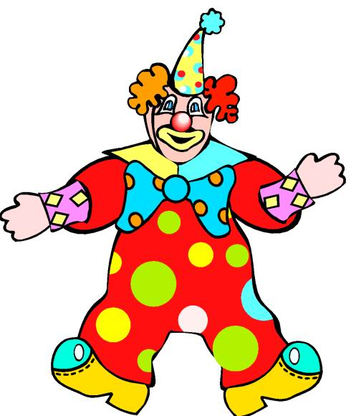
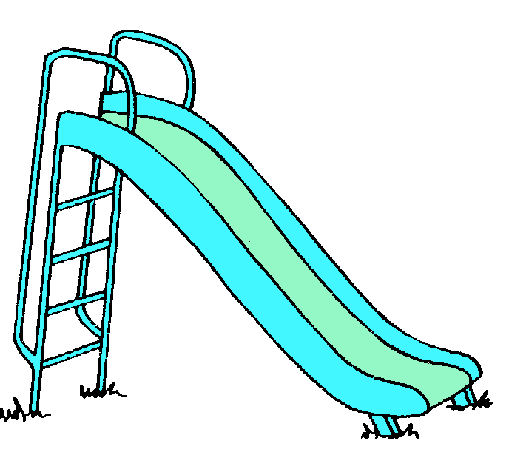
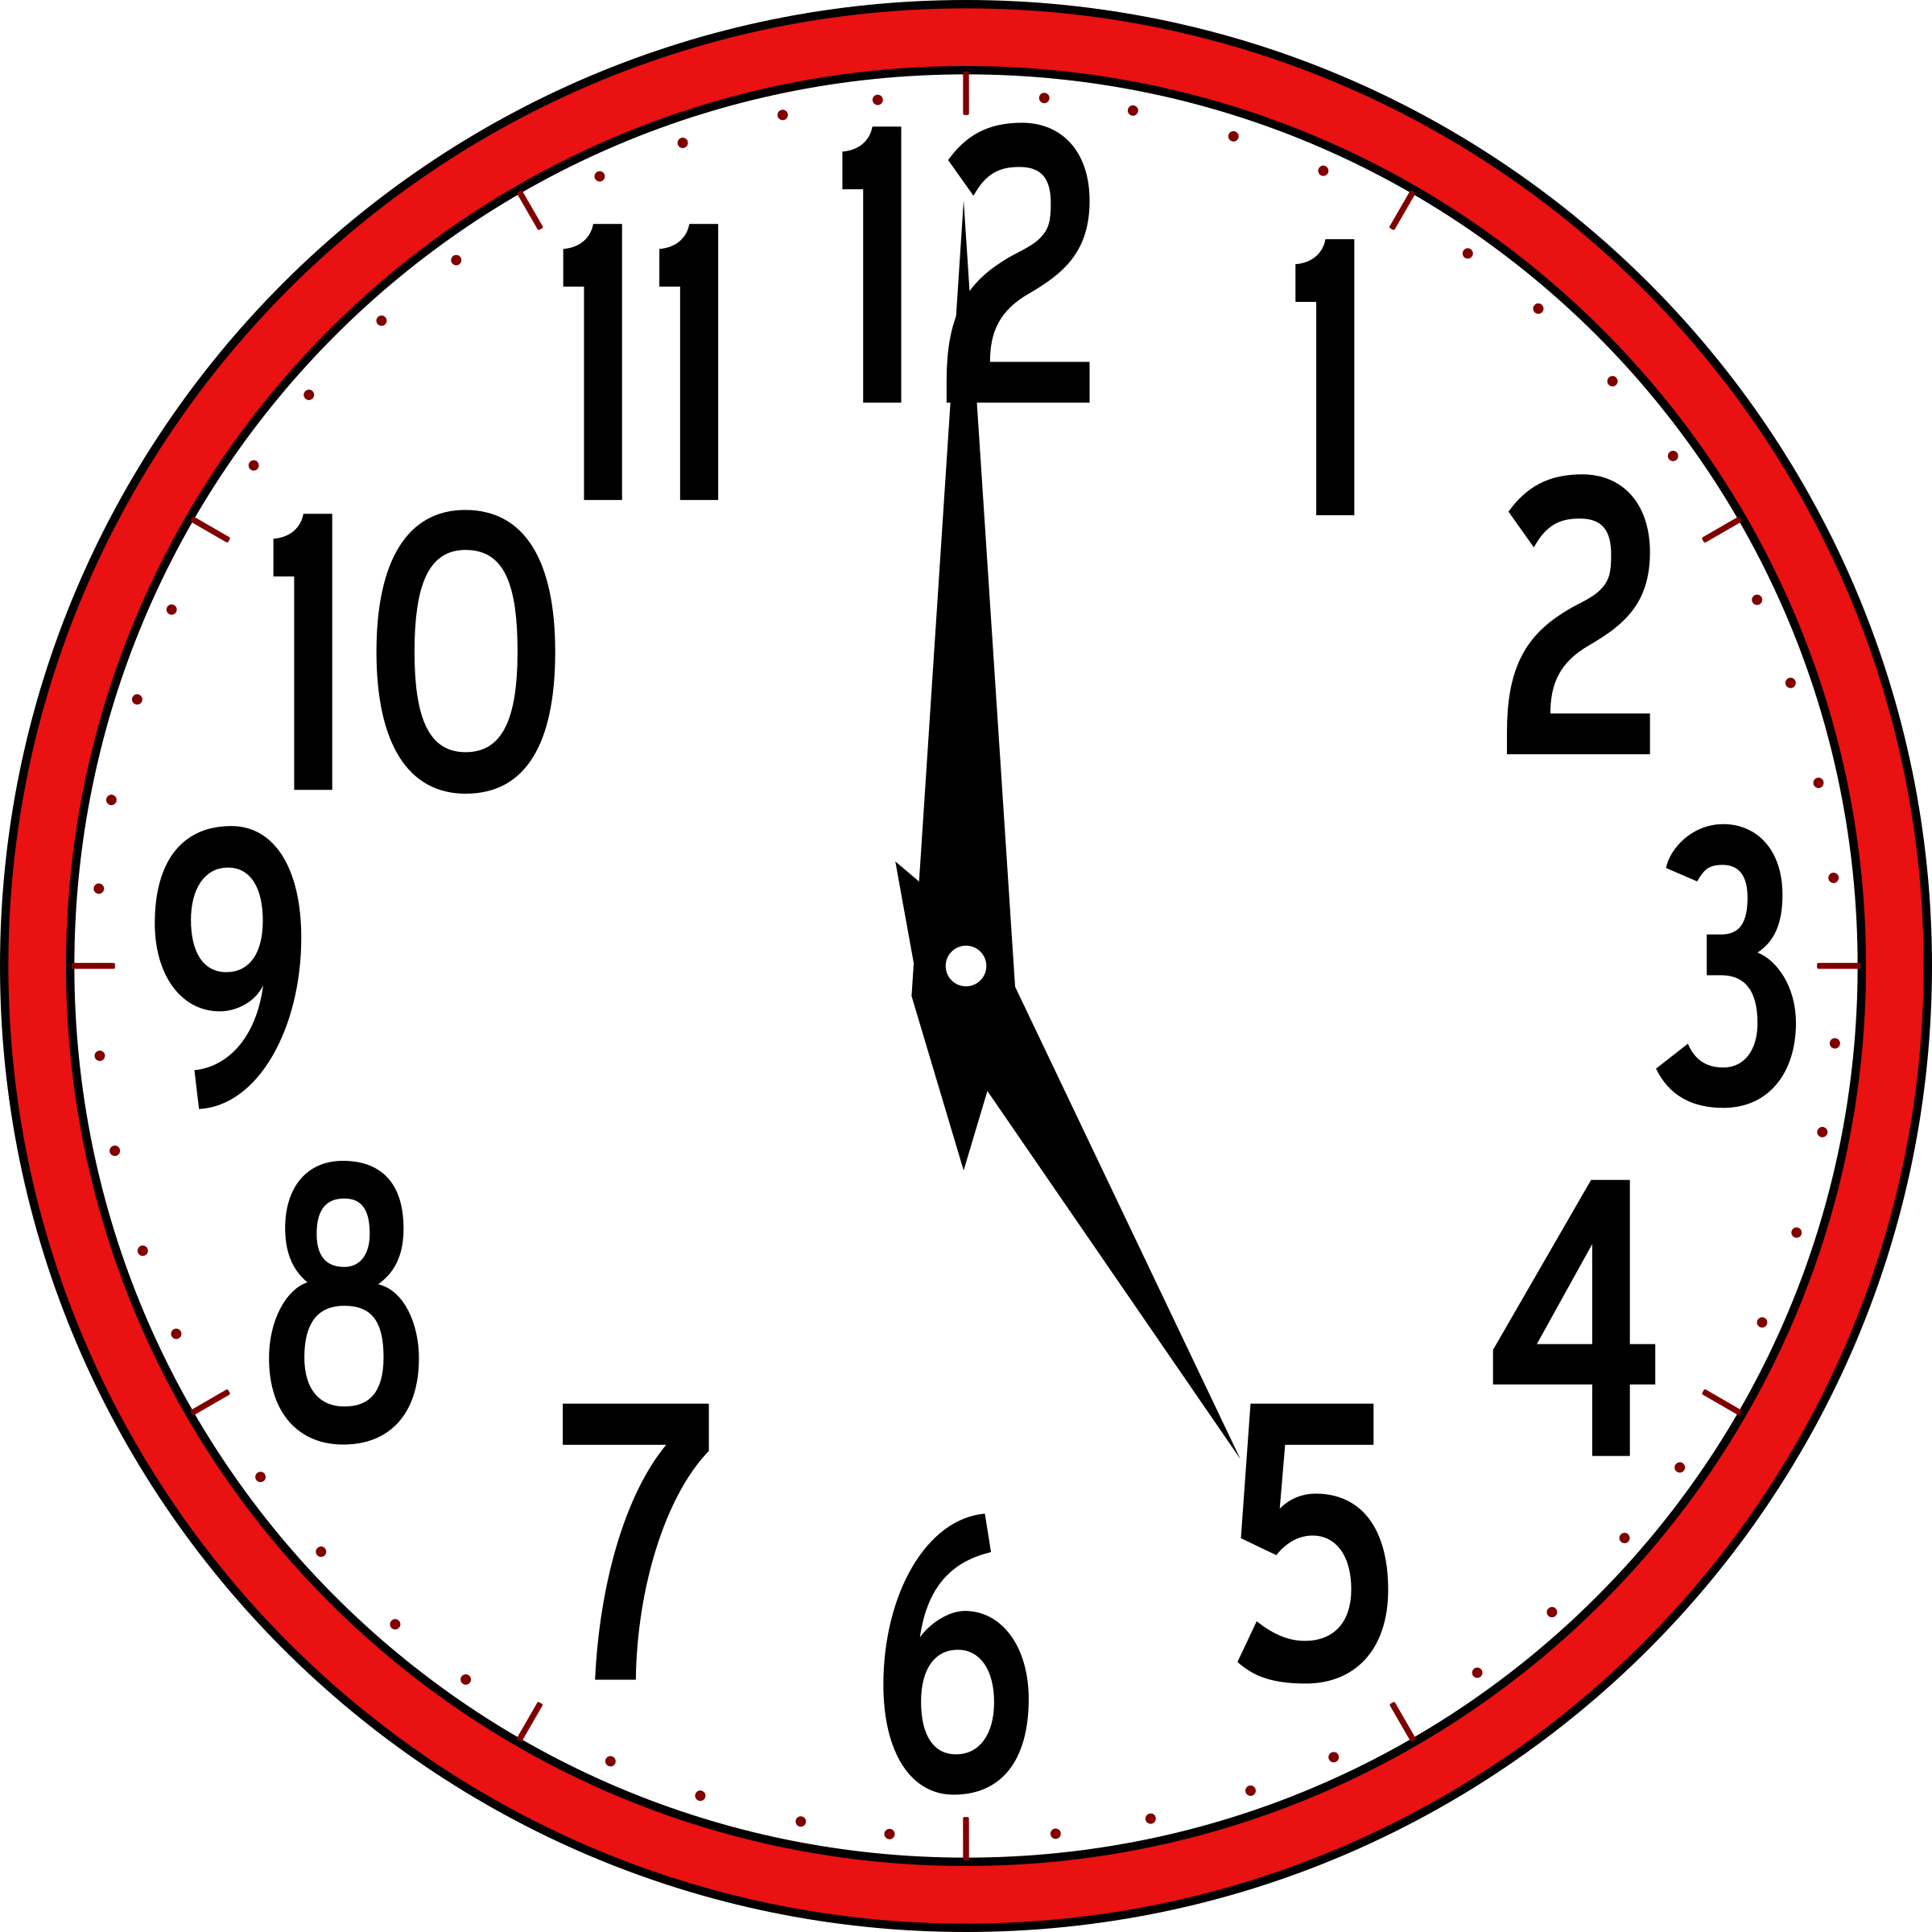
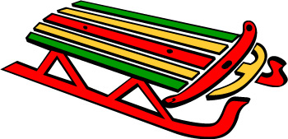
Name

Slide 11
Name
Double-click-to-type-here.
Double-click-to-type-here.
Double-click-to-type-here.
clown
clock
slippers
clip
sled
slide

Slide 12
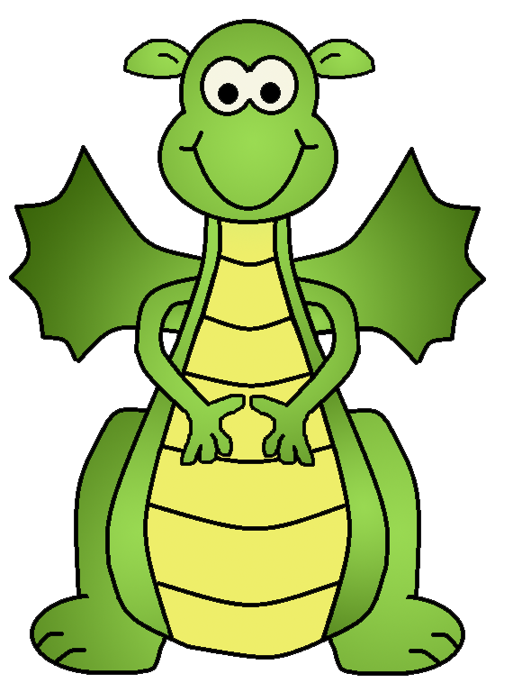
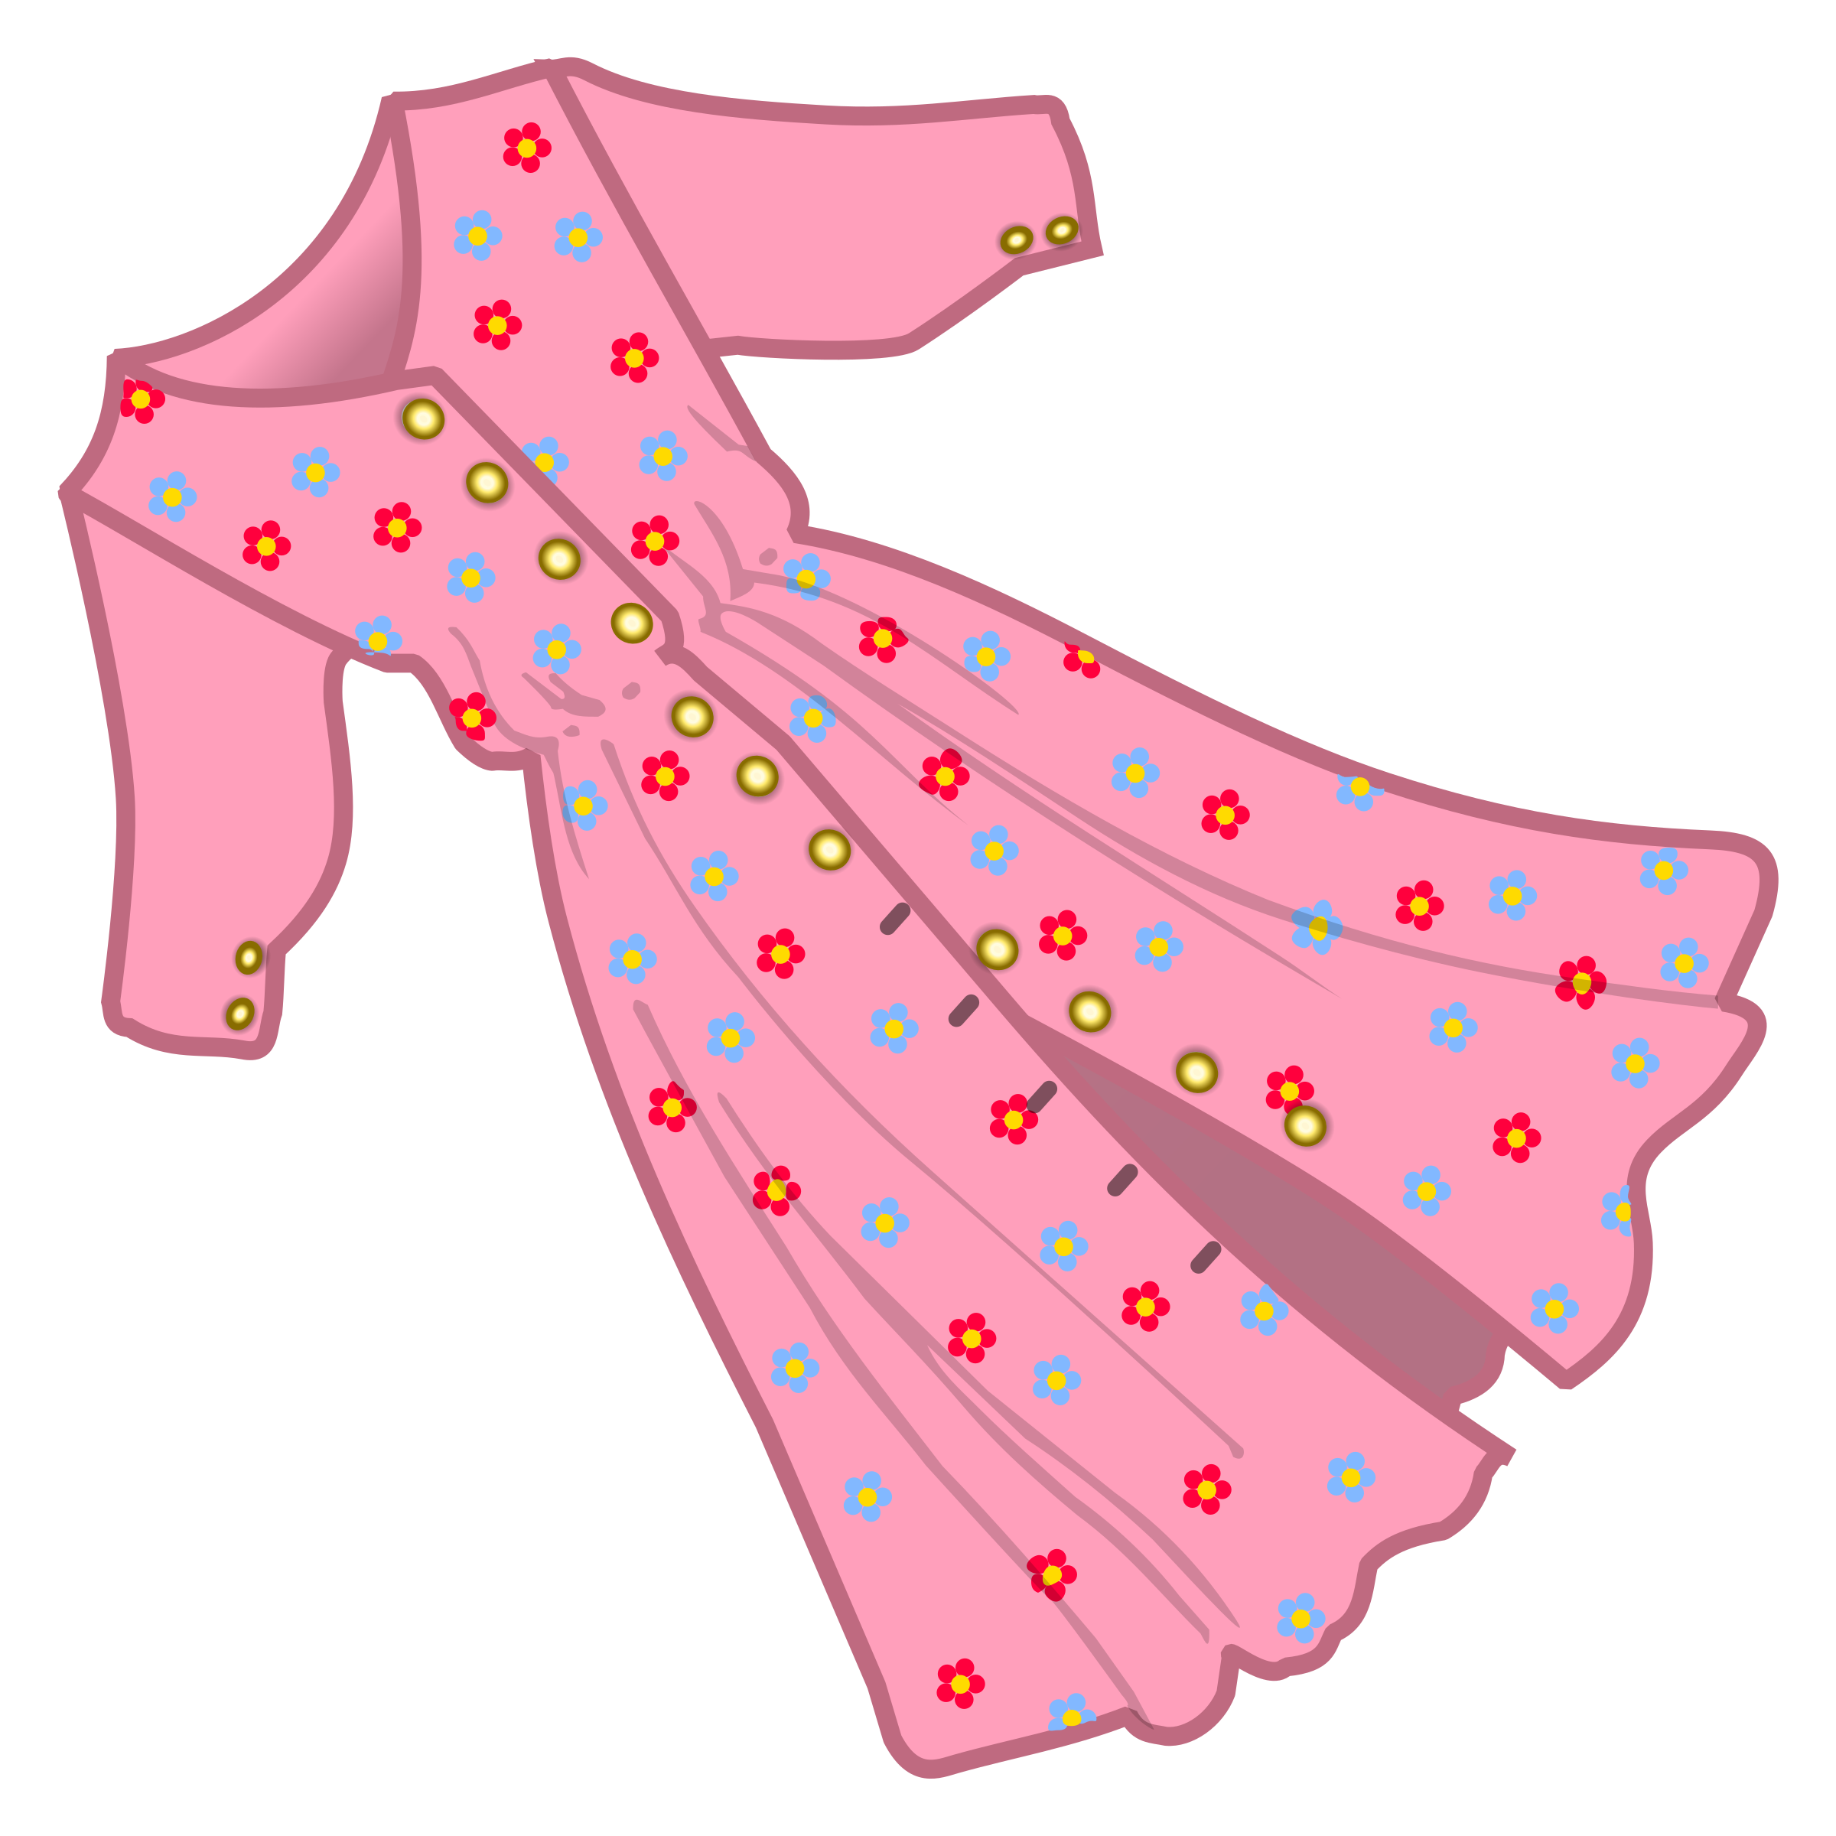
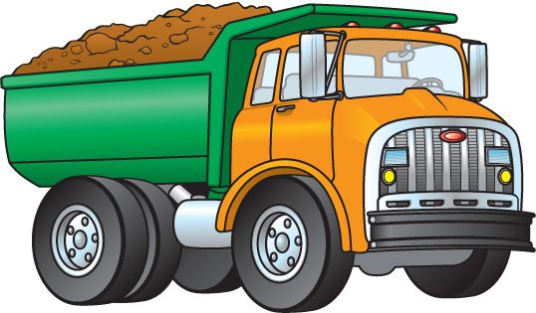
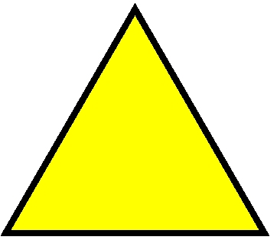
Name

Slide 13
Name
Double-click-to-type-here.
Double-click-to-type-here.
Double-click-to-type-here.
dragon
truck
tree
dress
drum
triangle

Slide 14
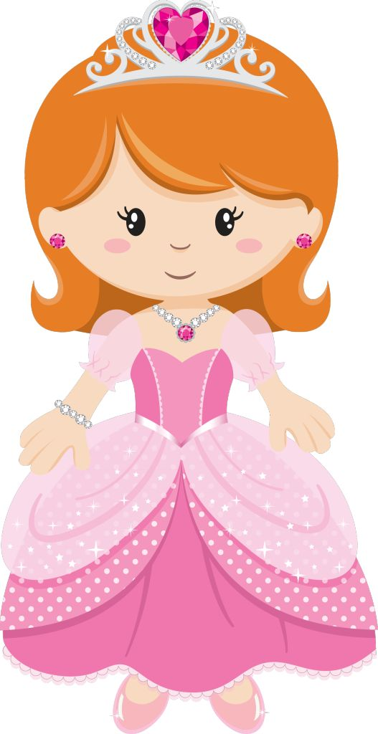
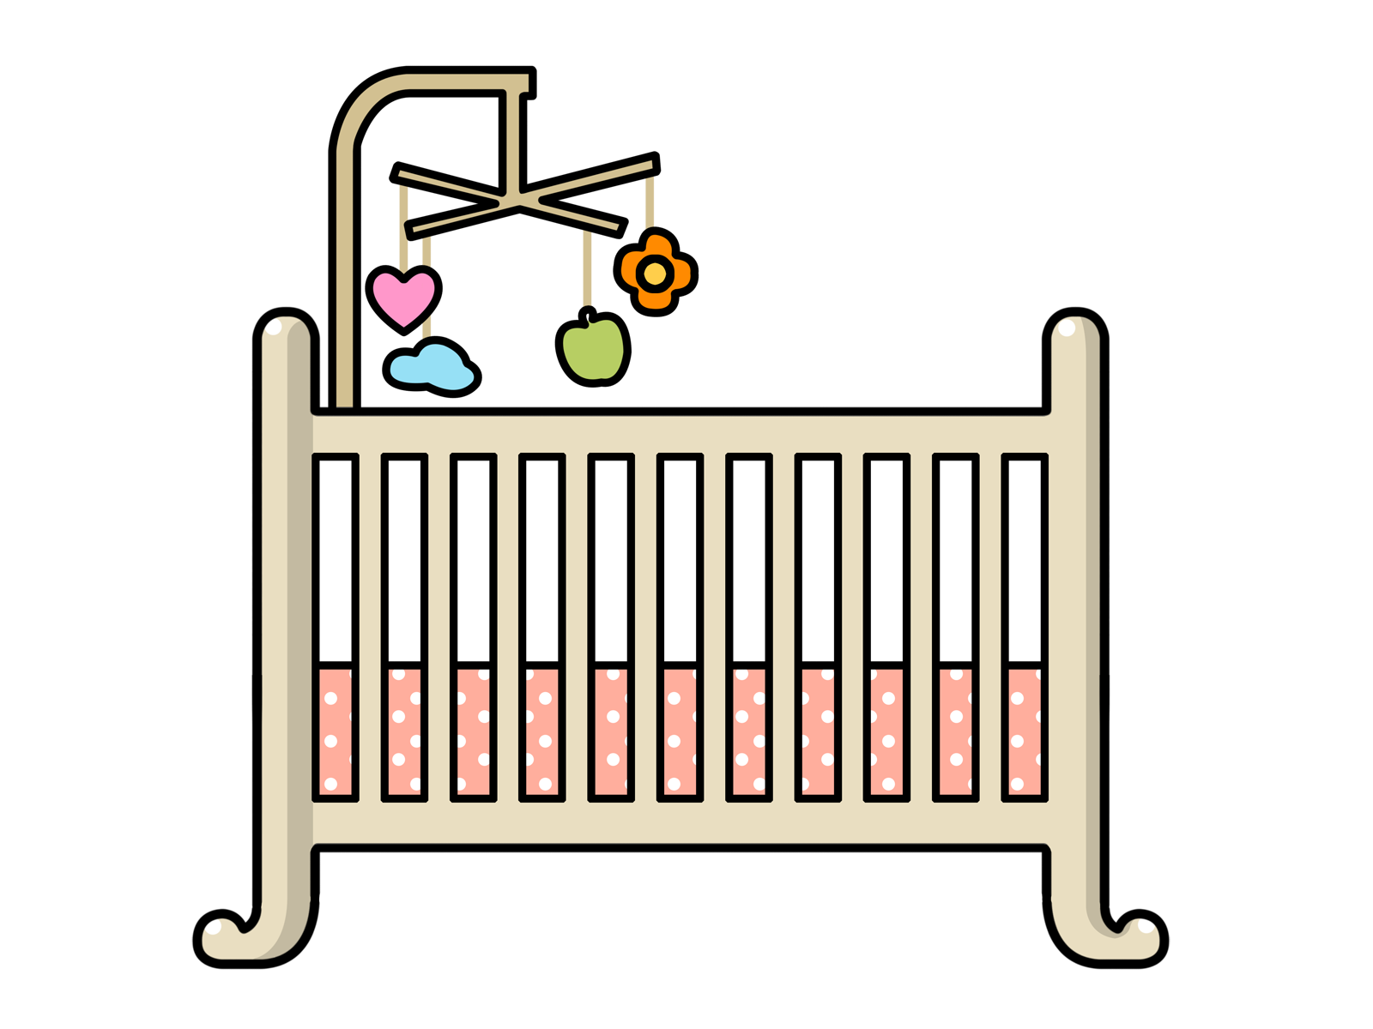
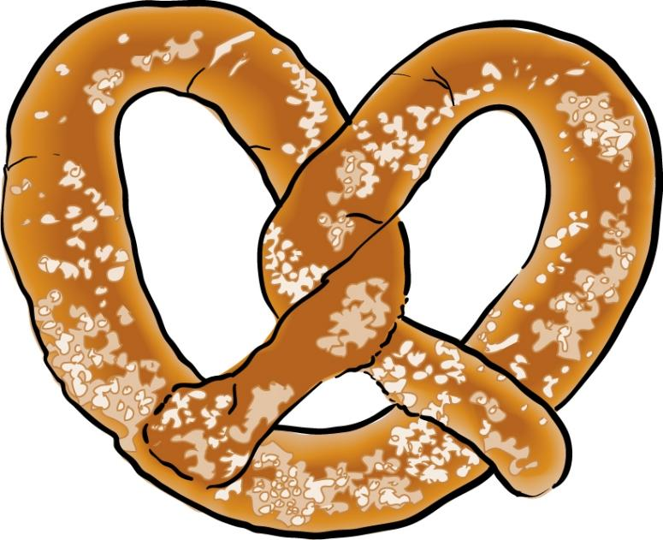
Name

Slide 15
Name
Double-click-to-type-here.
Double-click-to-type-here.
Double-click-to-type-here.
present
princess
crib
crab
crown
pretzel

Slide 16
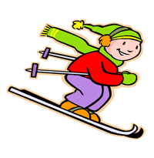
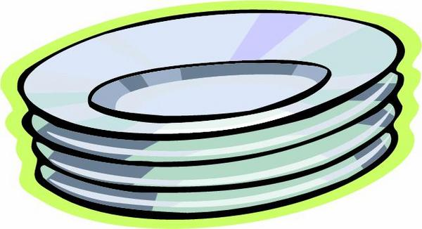
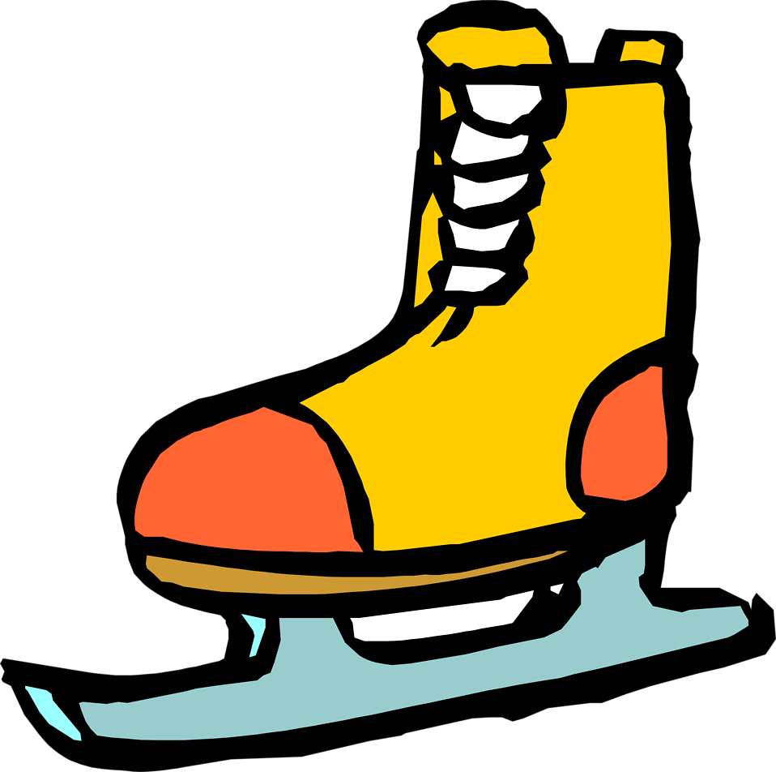
Name

Slide 17
Name
Double-click-to-type-here.
Double-click-to-type-here.
Double-click-to-type-here.
planet
plant
ski
skull
plates
skate

