Slide 1


Slide 2
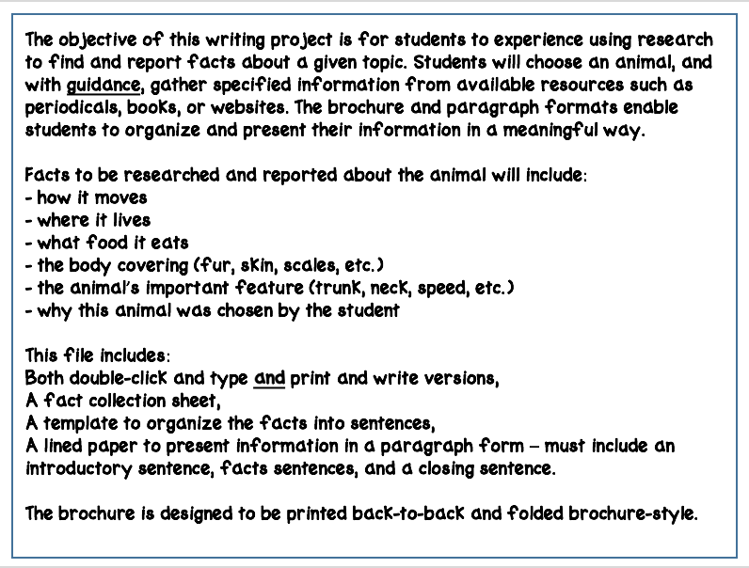

Slide 3
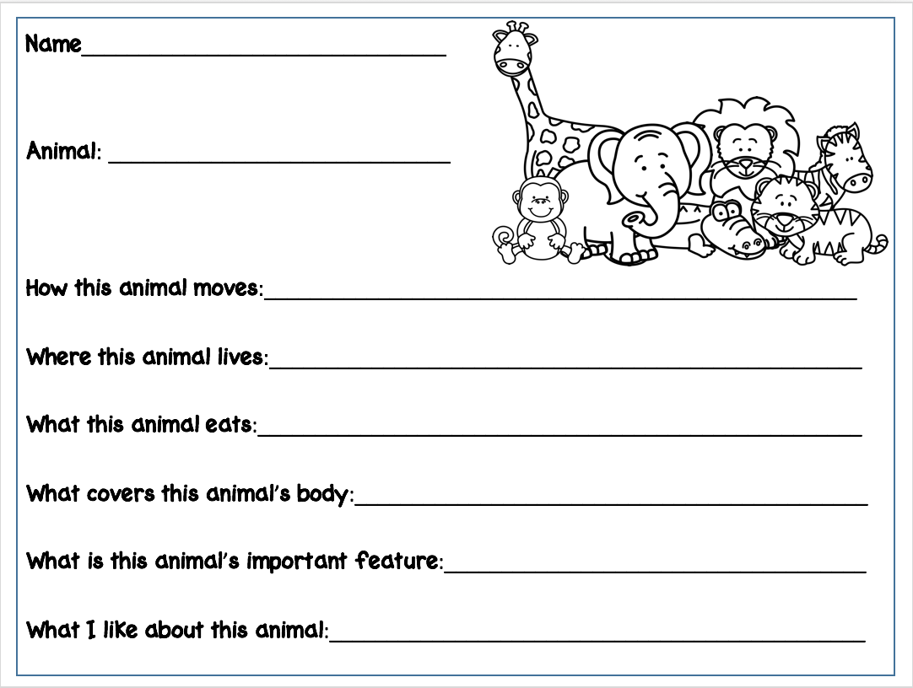
Name
Animal
?
?
?
?
?
?

Slide 4
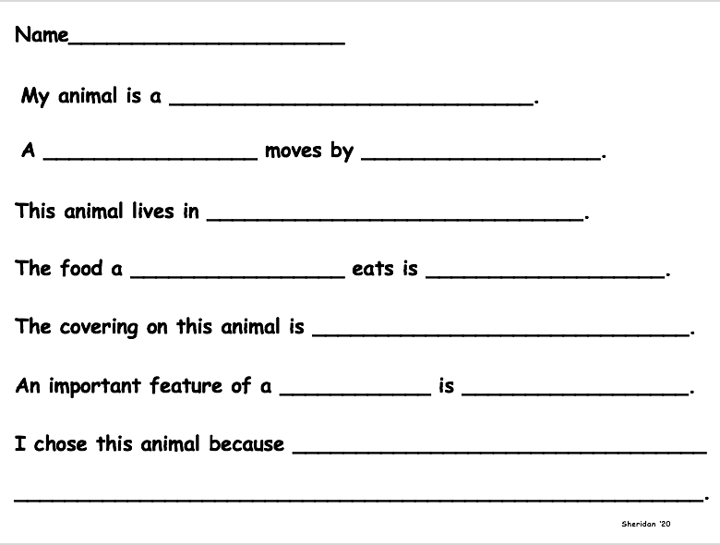
Name
Fill-in-your-animal.
Fill-in-your-animal
How-does-it-move?
Where-does-it-live?
Fill-in-your-animal
What-does-it-eat?
What-is-its-covering?
your-animal
the-feature.
Tell-why-you-like-the-animal-you-picked.

Slide 5
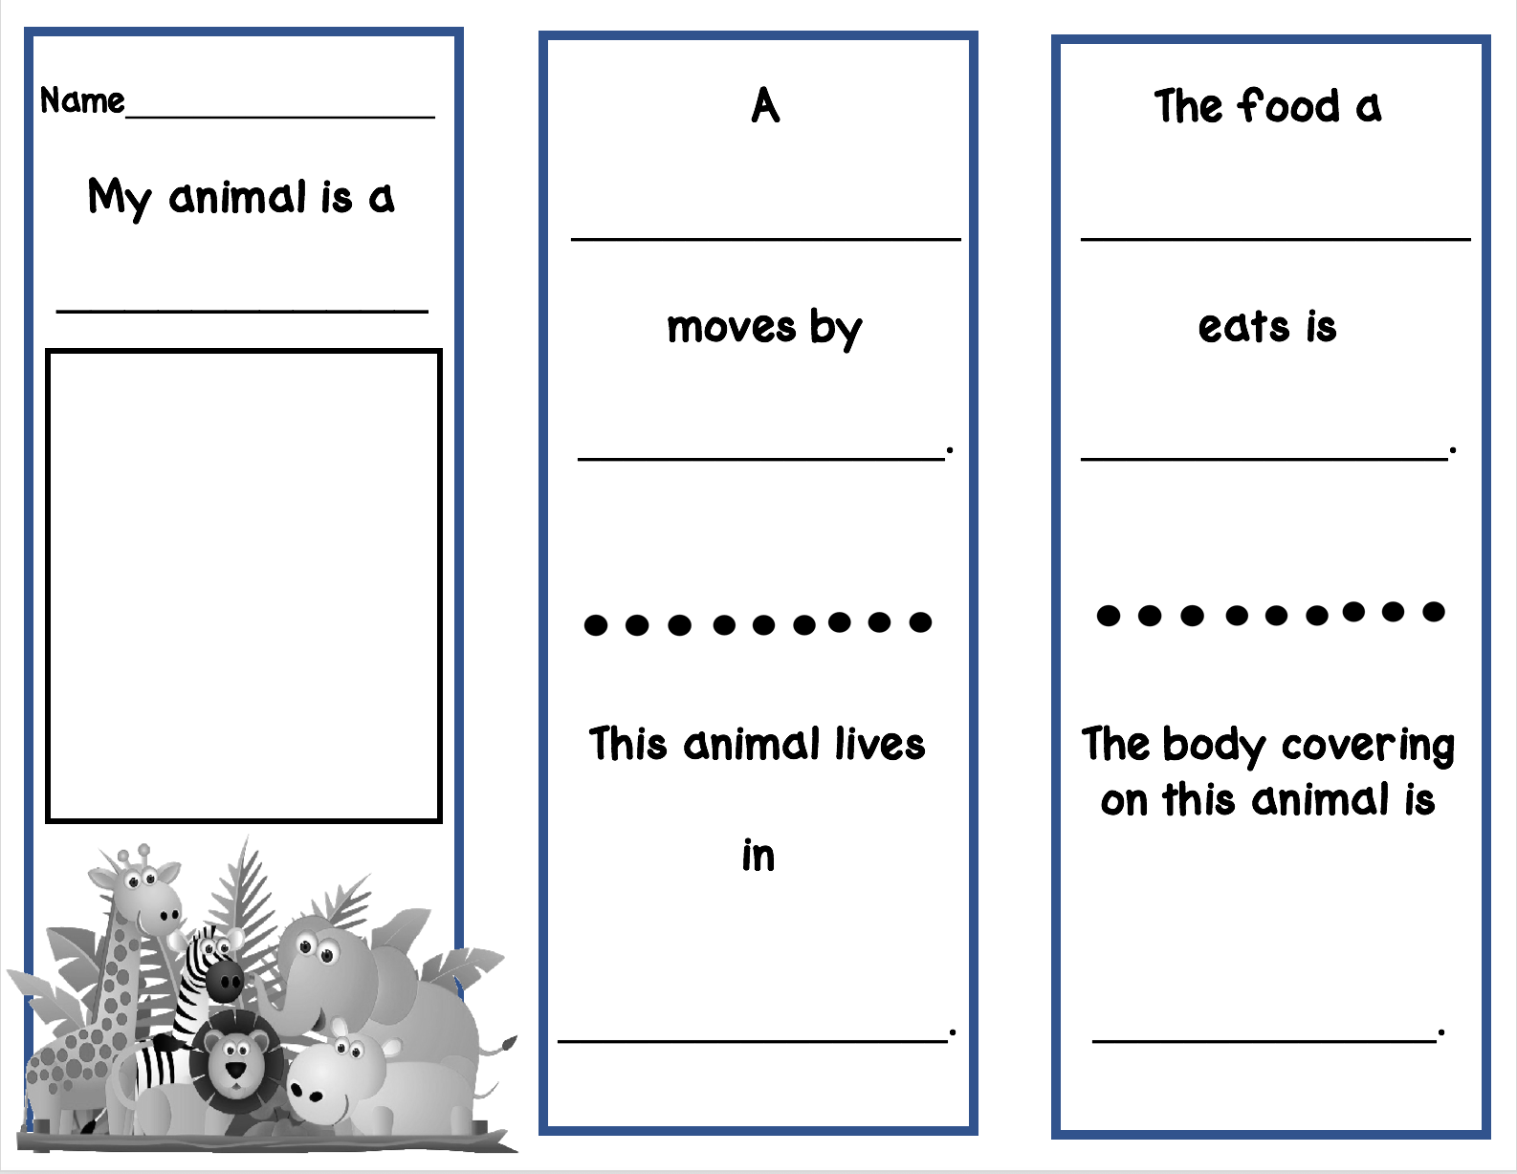
Name
Fill-in-your-animal.
Fill in your animal.
Fill-in-your-animal.
How-does-it-move?
What does it eat?
Where-does-it-live?
What is its covering?

Slide 6
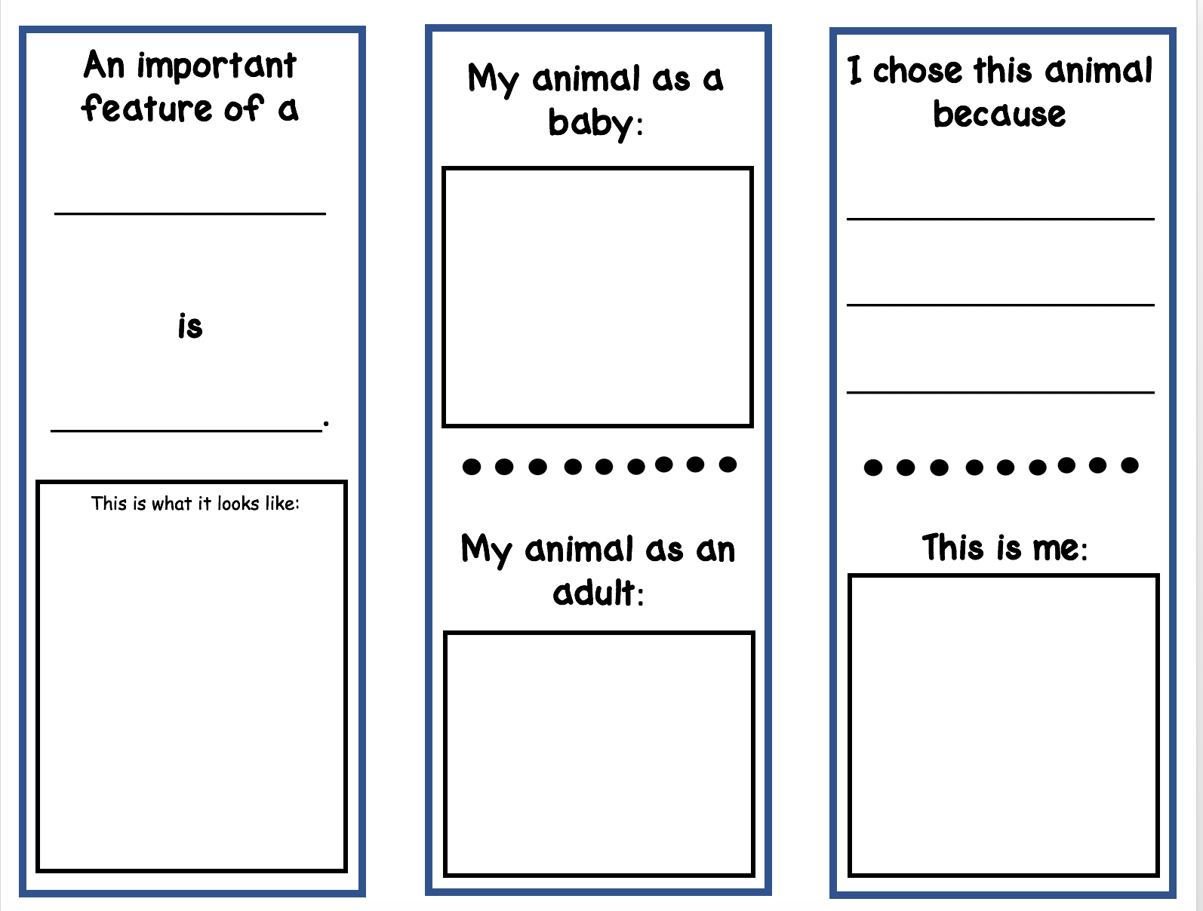
Fill-in-your-animal.
Tell-why-you-like
the-animal-you
picked.
Name-the-feature.

Slide 7

Animal
Write-here

